Slide 1
Machine Learning Model On
Food Delivery Time Prediction
By – Rahul Nair

Slide 2




Model Summary
References & Comments
Objective
Approach
Results
Inference
Problem Statement
Stakeholders
Business Use Case
1
Predict the time in minutes to deliver Swiggy orders from origin to destination
Project is a regression problem that has input features about:
Rider
Delivery vehicle
Weather conditions
Traffic
Location of restaurant
Location of Delivery
Swiggy
Improve Delivery Efficiency
Enhance Customer Satisfaction
Optimize Operational Costs
Swiggy
2
Delivery Agents / Riders
Rider
Plan pickups and drops
Can manage multiple orders
Avoid Risky Driving
Restaurants
Restaurant
Prioritization of Orders
Can manage staff for in house orders vs home deliveries
Customers
Customer
Experience of on-time delivery
No anxiety of order arrival

Slide 3
Model Summary
References & Comments
Objective
Approach
Results
Inference
Train Baseline Model
Further Models & Model Evaluation
Data Preparation
1
Build random forest, KNN, GB and LGBM models and evaluate the same
1
Clean the data for missing values, duplicates and other inconsistencies
1
Build a baseline linear regression model to check for the performance
Conduct univariate analysis to identify the features which have the highest correlation with target variable
2
Use Grid Search CV to identify the best hyperparameters and the best model
2
Build a baseline random forest model to compare with the linear regression model
2
3
Inference based on the best model

Slide 4
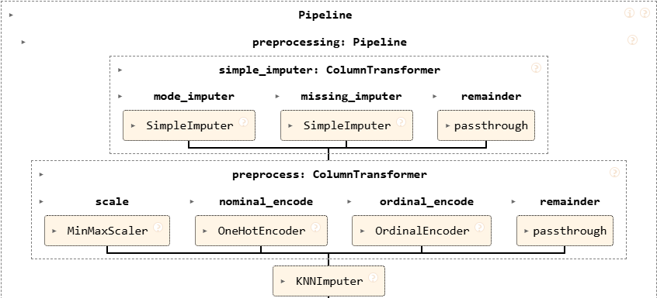
Model Summary
References & Comments
Objective
Approach
Results
Inference
Base line Models with missing data filled
1
Datapoints
2
Data Cleaning and EDA
Description | Count
Data | 45,593
Cleaned Data | 45,502
Missing values | 7,438
Train Data | 36,401
Test Data | 9,101
Data Cleaning
Remove duplicate values
Remove columns with data inconsistency
EDA
Conduct Anova and Chi square test to identify the relationship between the variables
3
Preprocessing Steps
4
Machine Learning Models & Metrics
Models used
Linear Regression
Random Forest
Metrics used –
Mean Absolute Error
R2 score

Slide 5
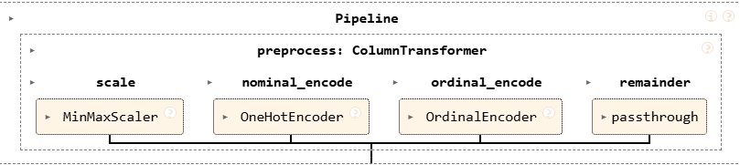
Model Summary
References & Comments
Objective
Approach
Results
Inference
Base line Models with missing data removed
3
Preprocessing Steps
4
Machine Learning Models & Metrics
Models used
Linear Regression
Random Forest
Metrics used –
Mean Absolute Error
R2 score
Ensemble Model with missing data removed
3
Preprocessing Steps
5
Models used in Grid Search CV
Model Name | Hyperparameters in Grid Search CV
Random Forest | 1. n_estimators - 10, 100, 200 2. max_depth - 2, 20
XGBoost | 1. n_estimators - 10, 100, 200 2. max_depth - 2, 20 3. learning_rate - 0.1, 0.5
LGBM | n_estimators - 10, 100, 200 2. max_depth - 2, 20 3. learning_rate – 0.1, 0.5
KNN | 1. n_neighbours - 1, 25 2. weights – ‘uniform’, ‘distance’
Averaging Ensemble Model | XGBoost – n_estimators – 100, max_depth – 20, learning rate – 0.1 LGBM - n_estimators – 200, max_depth – 20, learning rate – 0.1
4
Parameters of Grid Search CV
CV=5
Scoring – neg_mean_absolute_error

Slide 6
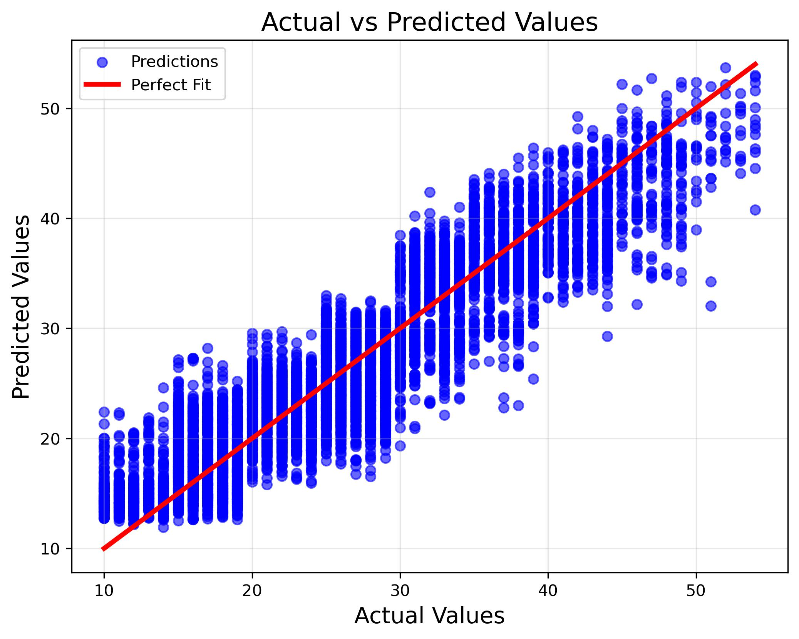
Model Summary
References & Comments
Objective
Approach
Results
Inference
Model Performance
Actual vs Predicted values
 | Model Name | MAE |  | R2 score
 |  | Train | Test | Train | Test
Baseline Model | Linear Regression (Missing values dropped) | 4.67 min | 4.73 min | 0.60 | 0.60
 | Linear Regression (Missing values filled) | 4.82 min | 4.85 min | 0.58 | 0.58
 | Random Forest (Missing values dropped) | 1.15 min | 3.13 min | 0.98 | 0.83
 | Random Forest (Missing values filled) | 1.22 min | 3.28 min | 0.97 | 0.80
Grid Search CV | Random Forest | 1.29 min | 3.12 min | 0.97 | 0.83
 | LGBM | 2.82 min | 3.06 min | 0.86 | 0.84
 | XGBoost | 1.53 min | 3.10 min | 0.96 | 0.83
 | KNN | 0 min | 4.26 min | 1.00 | 0.66
Ensemble model | Averaging of XGBoost & LGBM | 2.15 min | 3.05 min | 0.92 | 0.84
Base Line Model
Hyperparameters of LGBM
Hyperparameters of XGBoost
Learning_Rate – 0.1
Max_Depth – 20
N_Estimators – 200
Learning_Rate – 0.1
Max_Depth – 20
N_Estimators – 100
Build Complex Models
Build Complex Models

Slide 7
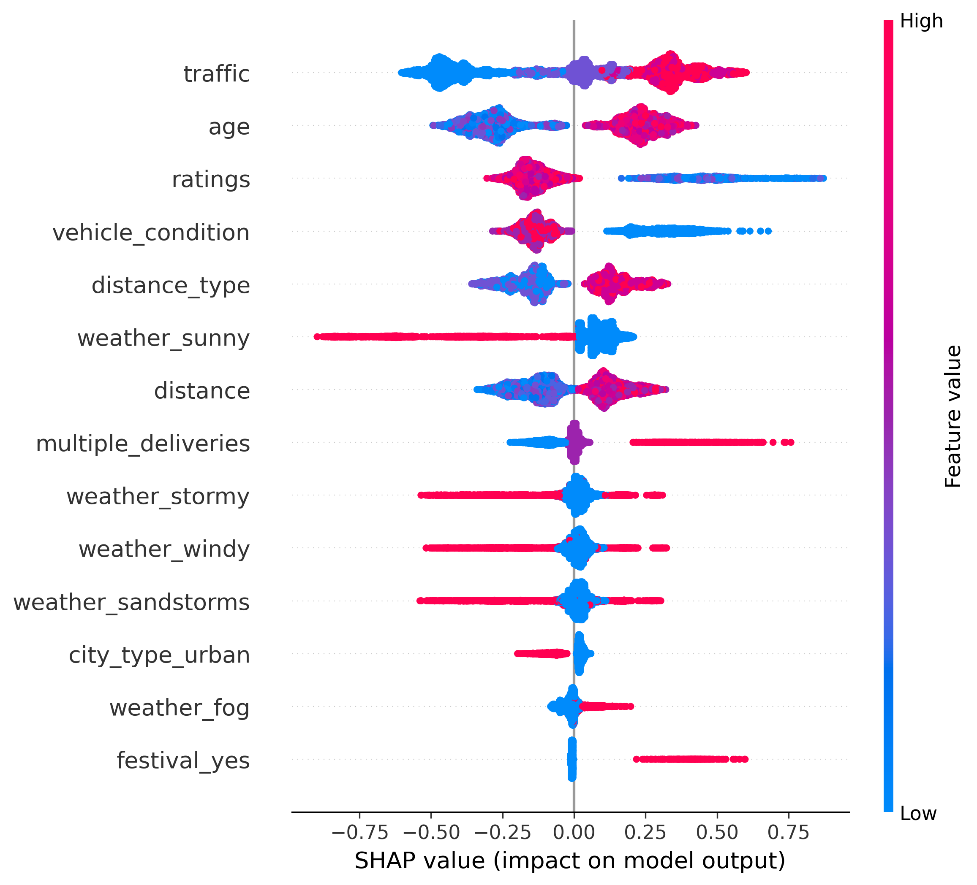
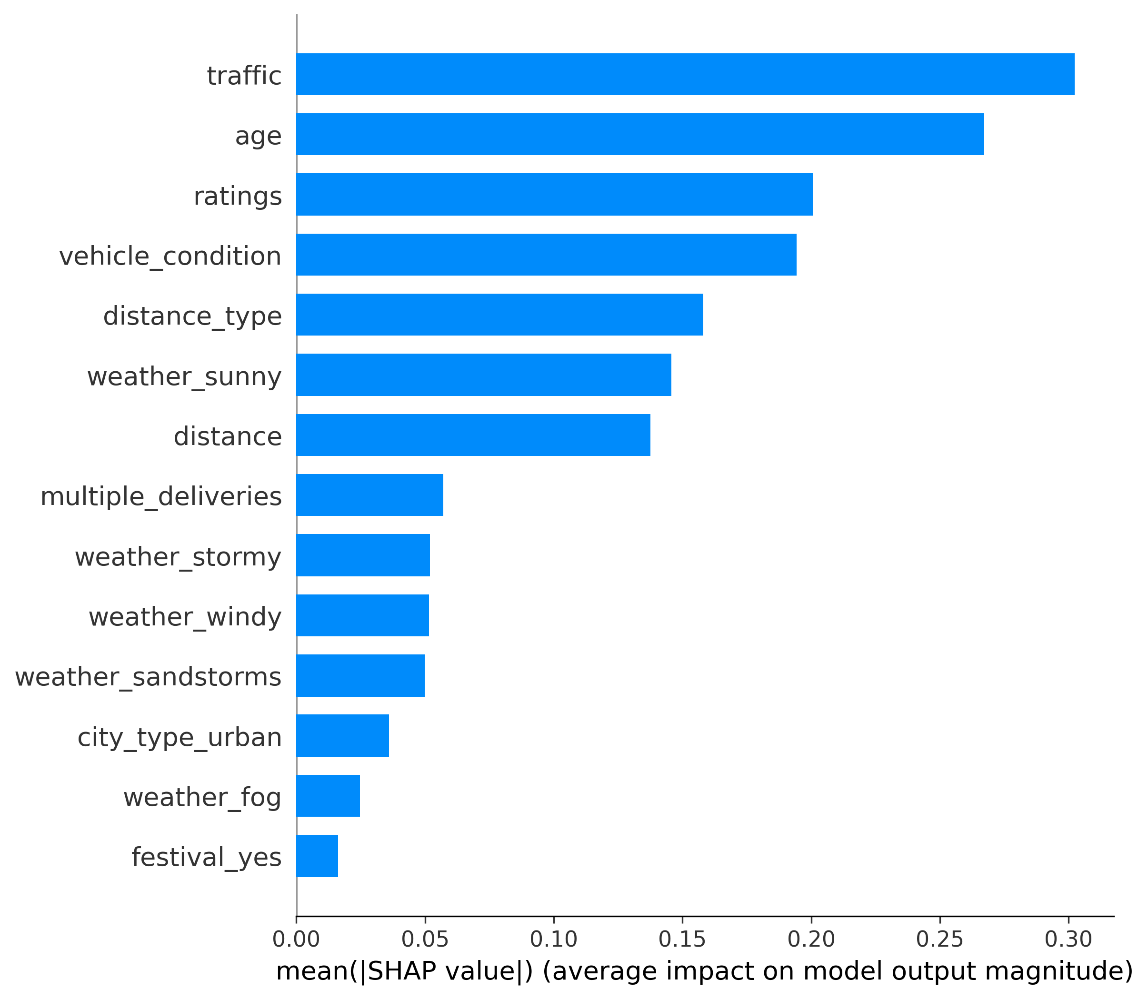
Model Summary
References & Comments
Objective
Approach
Results
Inference
Shapley Summary Plot of Features
Feature Importance – Bar Plot
Base Line Model
Build Complex Models

Slide 8
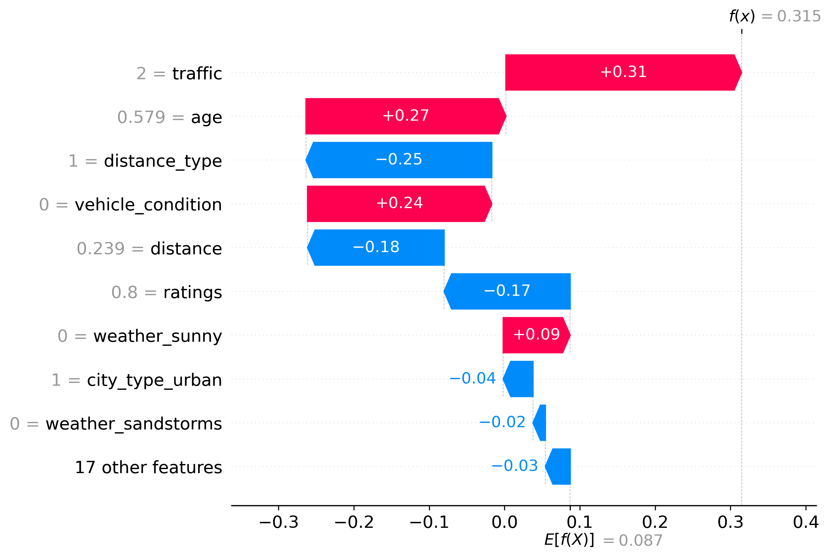
Model Summary
References & Comments
Objective
Approach
Results
Inference
Impact on Features on Final Output for 1 instance
Original Values
Base Line Model
Build Complex Models
E(f(x)) – 26.33 minutes
f(x) – 28.52 minutes

Slide 9
Model Summary
References & Comments
Objective
Approach
Results
Inference
REFERENCES
COMMENTS ON NEXT STEPS
1
Code & Dataset Link
https://github.com/rahulnair2402/IIT-Roorkee-Capstone-Project---Food-Delivery-Prediction/tree/Project-branch
Dataset source https://www.kaggle.com/datasets/gauravmalik26/food-delivery-dataset?select=train.csv
Hands-On Machine Learning with Scikit-Learn, Keras, and Tensorflow - Aurelien Geron
Chen, T., & Guestrin, C. (2016). XGBoost: A Scalable Tree Boosting System. In Proceedings of the 22nd ACM SIGKDD International Conference on Knowledge Discovery and Data Mining (pp. 785–794)
LightGBM: A Highly Efficient Gradient Boosting Decision Tree
Ensemble Methods: Foundations and Algorithms
1
Optuna for Hyperparameter Tuning:
Use Optuna to optimize the hyperparameter space more efficiently than Grid Search CV
Leverage techniques like Bayesian Optimization and early pruning of unpromising trials
Deployment and Monitoring:
Use frameworks like Flask, FastAPI, or Django to expose the model as an API.
Implement monitoring tools to track prediction accuracy and latency after deployment
2
3
2
4
5
6

